Slide 1
Lecture 9: Financial Services and Supertype/Subtype
Chapter 10

Slide 2
Financial Services
Financial Processes
Retail banking, credit card accounts, insurance, loan, mortgage, investment, financial portfolio
BI user requirements
Historical monthly snapshot data on every account
Household identification
﻿Market more eﬀectively by oﬀering additional products to households
Many more…

Slide 3
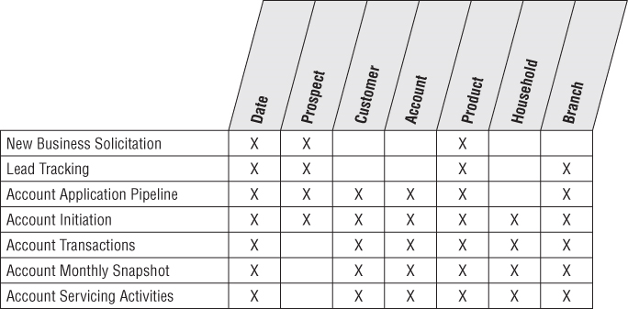
Subset of Bus Matrix Rows of a Bank

Slide 4
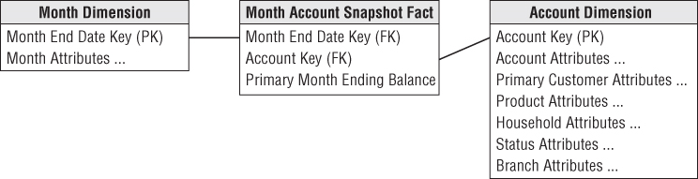
Grain and Simple Schema
What is the grain of the fact table?
One row for primary balance of each account each month.
Is it fully additive?

Slide 5
Problems with too few dimensions
﻿It does not adequately reflect the natural business dimensions.
Additional analytic dimensions such as product and branch mirror the instinctive way users think about their business.
﻿Provide much smaller points of entry to the fact table.
Address both the performance and usability objectives of a dimensional model.
﻿The product and branch dimensions are two separate dimensions as there is a many-to-many relationship between products and branches.
Given a big bank may have millions of accounts, type 2 slowly changing dimension eﬀects potentially causing this huge dimension to mushroom into something unmanageable.

Slide 6
﻿Supplements to the dimensional model
﻿Most dimensional models end up with between five and 20 dimensions.
﻿Causal dimensions, such as promotion, contract, deal, store condition, or even weather.
﻿Degenerate dimensions that identify operational transaction control numbers, such as an order, an invoice, a bill of lading, or a ticket;
﻿Role-playing dimensions, such as when a single transaction has several business entities associated with it, each represented by a separate dimension.
﻿Status dimensions that identify the current status of a transaction or monthly snapshot within some larger context, such as an account status.
﻿An audit dimension;
﻿Junk dimensions of correlated indicators and flags

Slide 7
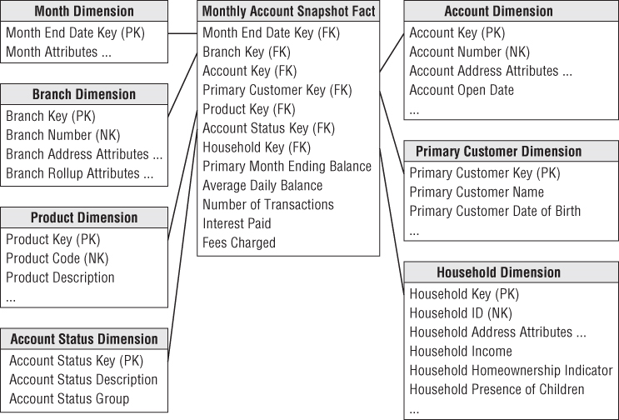
Snapshot Fact table for all Accounts

Slide 8
Dimension Details
Product Dimension:
﻿consists of a simple hierarchy that describes all the bank’s products, including the name of the product, type, and category.
Branch Dimension:
﻿similar to the facility dimensions, such as retail store;
Account status dimension:
﻿record the condition of the account at the end of each month.
﻿The status records whether the account is active or inactive, or whether a status change: new account opening or account closure

Slide 9
Dimension Details
Household Dimension:
﻿A household an entire economic unit has relationship with the bank;
﻿The overall profile of a household;
﻿The magnitude of the existing relationship with the household;
﻿What additional products should be sold to the household;
﻿Key demographics regarding the household, such as household income, whether they own or rent their home, whether they are retirees, and whether they have children;
Corporate “households” are common;

Slide 10
Household Dimension and Account Dimension
Household dimension and Account dimension are intuitively correlated, but separate dimensions;
﻿The account dimension is huge, with easily over 10 million rows that group into several million households.
﻿The household dimension provides a somewhat smaller point of entry into the fact table, without traversing a 10 million-row account dimension table.
﻿Avoid using the type 2 slowly changing dimension technique: the changing nature of the relationship between accounts and households, use the fact table to capture the relationship;

Slide 11
﻿Mini-Dimensions Revisited
﻿There are a wide variety of attributes describing the bank’s accounts, customers, and households;
including monthly credit bureau attributes, external demographic data, and calculated scores to identify their behavior, retention, profitability, and delinquency characteristics.
﻿Break oﬀ the browseable and changeable attributes into multiple mini-dimensions, such as credit bureau and demographics mini-dimensions;

Slide 12
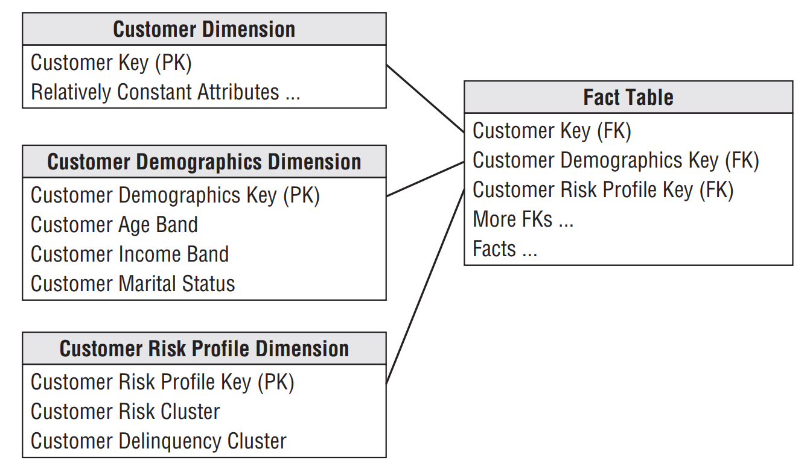
﻿Multiple mini-dimensions associated with a fact table

Slide 13
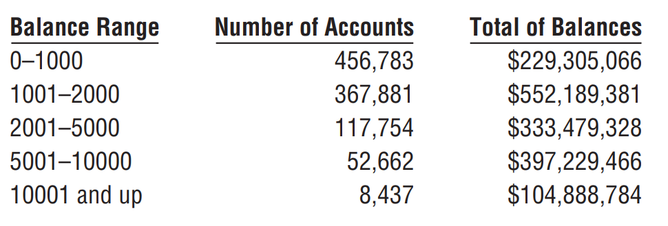
﻿Dynamic Value Banding of Facts
A dynamic value banding report is organized as a series of report row headers that deﬁne a progressive set of varying-sized ranges of a target numeric fact.
“Balance from 0 to $10,” “Balance from $10.01 to $25,”
Dynamic because the speciﬁc row headers are deﬁned at query time, not during the ETL processing.

Slide 14
Dynamic Value Banding of Facts
﻿It is difficult to create this report directly from the fact table.
﻿SQL has no generalization of the GROUP BY clause that clumps additive values into ranges.
﻿The ranges are of unequal size and have textual names, such as “10001 and up.”
﻿Users typically need the flexibility to redefine the bands at query time with diﬀerent boundaries or levels of precision.

Slide 15
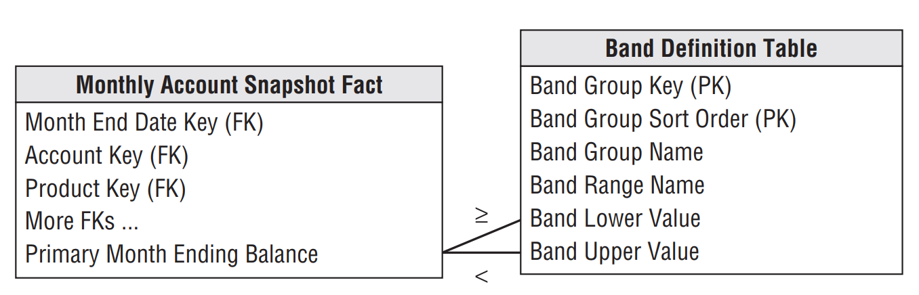
Dynamic Value Banding of Facts
﻿The band definition table can contain as many sets of diﬀerent reporting bands as desired.

Slide 16
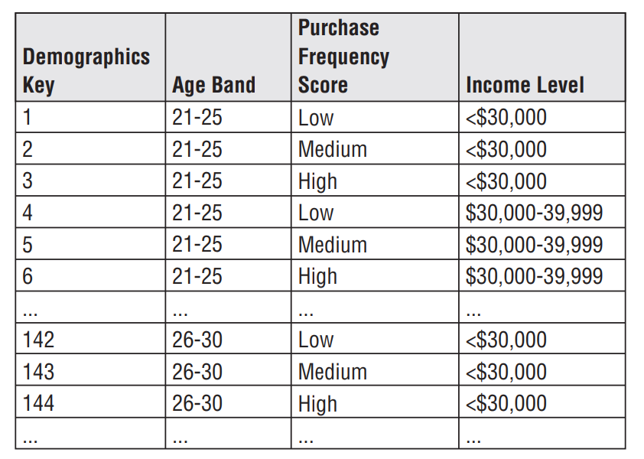
Dynamic Value Banding of Facts
﻿The name of a particular group of bands is stored in the band group column.
The band definition table is joined to the balance fact using a pair of less-than and greater-than joins.
The report uses the band range name as the row header.
More dynamic than fixed range:

Slide 17
﻿Supertype and Subtype Schemas for Heterogeneous Products
﻿A typical retail bank oﬀers a myriad of products, from checking accounts to credit cards, to the same customers.
﻿Each product type has many special attributes and measured facts that are not shared by the other products.
﻿Checking accounts have minimum balances, overdraft limits, service charges, and other measures relating to online banking;
Time deposits such as certificates of deposit have maturity dates, compounding frequencies, and current interest rate.

Slide 18
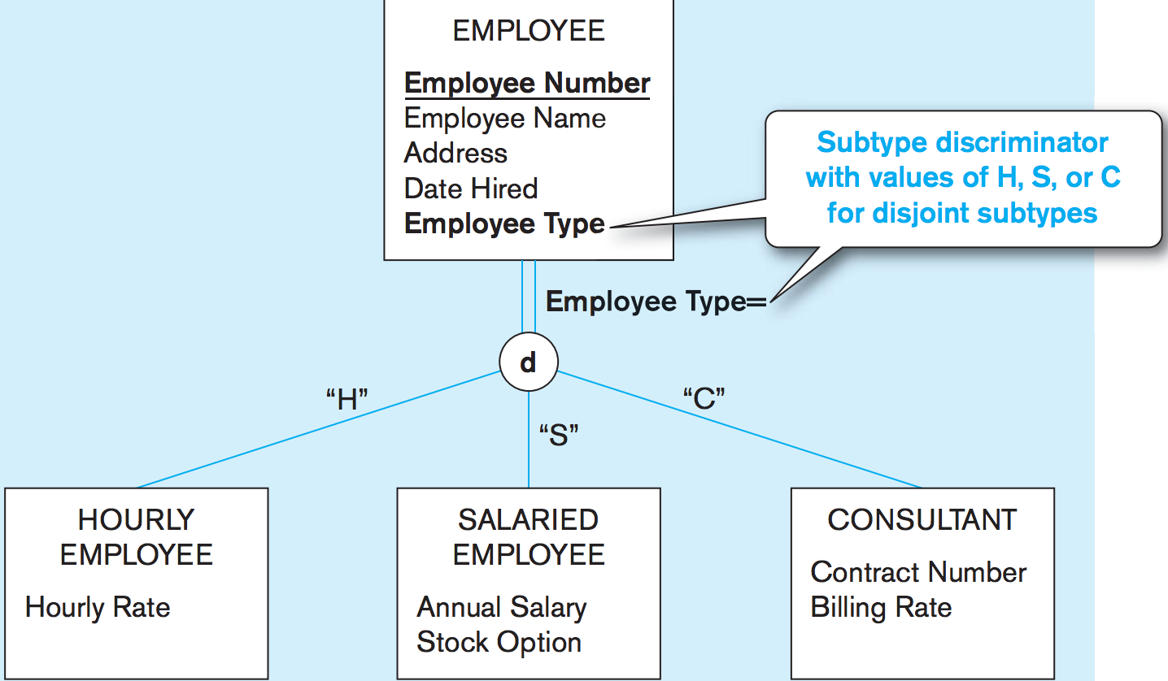
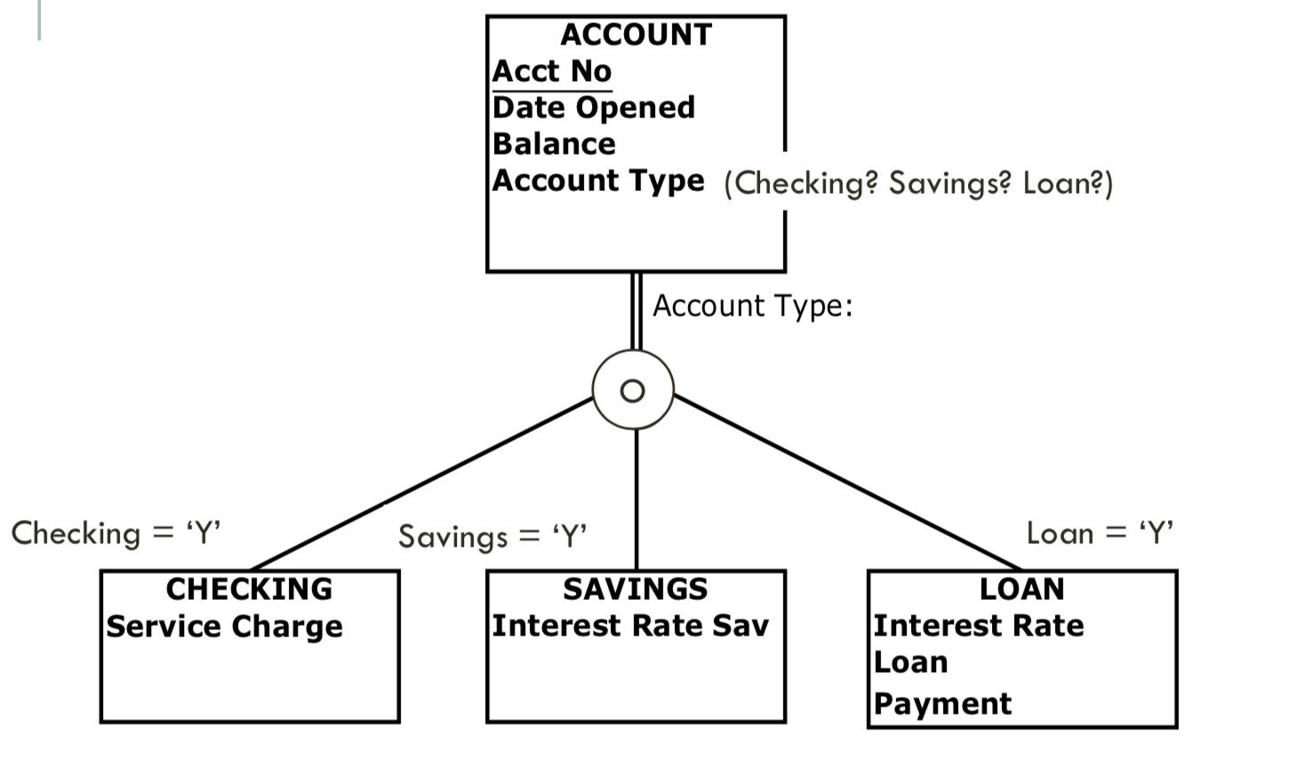
Supertype and Subtype

Slide 19
Supertype and Subtype for Heterogeneous Products
Business owners typically require two different perspectives:
Global view
Line-of-business view
Global view: Insight into the complete account portfolio across all lines of business.
Line-of-business: Focus on the in-depth details of one business, such as checking.
(Single supertype fact table)
(Special subtype fact table for each LOB)

Slide 20
Supertype Fact table for all Accounts

Slide 21
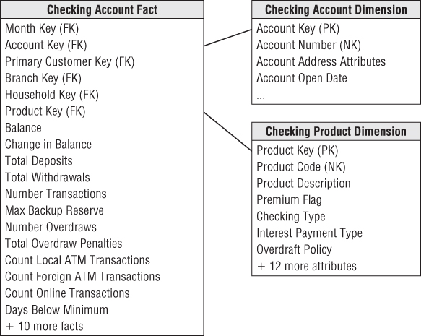
LOB Subtype Schema for Checking

Slide 22
Supertype and Subtype
Supertype fact table can represent only a limited number of facts across all line of business.
Subtype schema must also contain the supertype fact attributes to avoid joining tables from supertype and subtype schemas.
A specific product would be assigned the same surrogate product key in both the supertype and subtype product dimensions.
﻿Subtype tables provide a disjointed partitioning of the accounts, so there is no overlap between the subtype schemas.
A family of supertype and subtype are needed when a business has heterogeneous products but a single customer base.

Slide 23
More examples in other domains
﻿Supertypes and Subtypes for Charges in Healthcare:
﻿Facility charges for inpatient hospital stays diﬀer from professional charges for outpatient treatments in clinics and doctor offices.
﻿Insurance companies typically are involved in multiple, very diﬀerent lines of business.
﻿the detailed parameters of homeowners’ coverages diﬀer significantly from automobile coverages, from personal property coverage, general liability coverage, and other types of insurance.

Slide 24
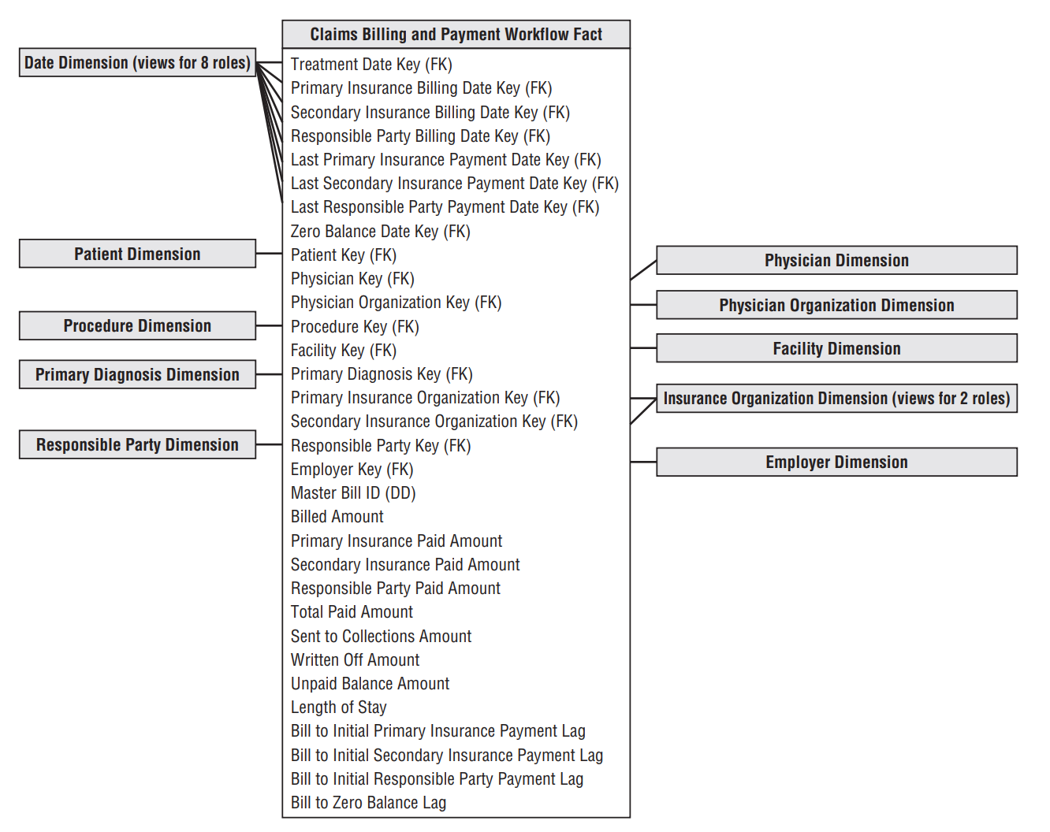
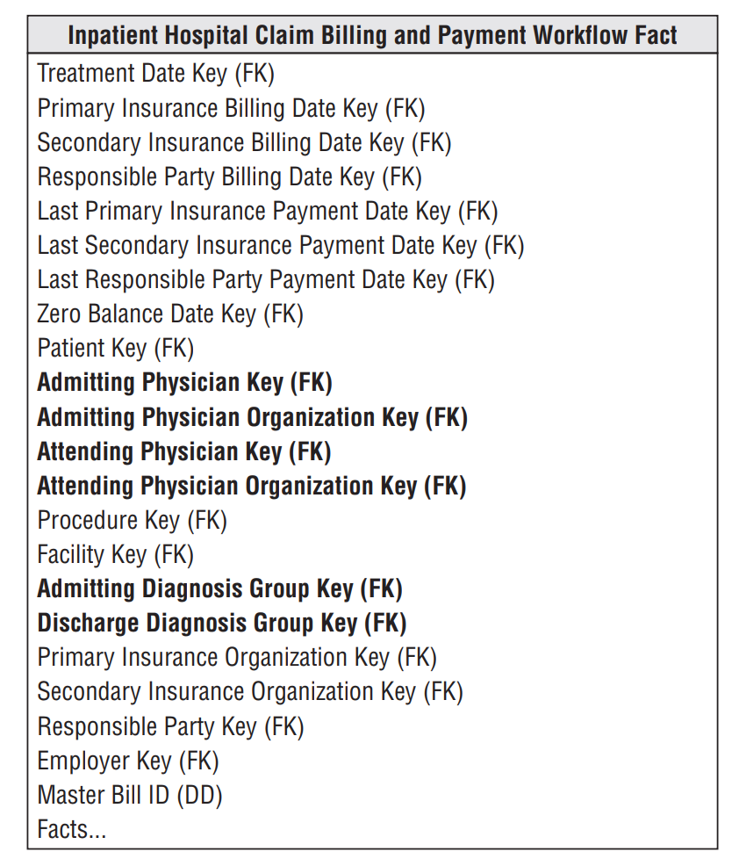
Supertype vs subtype in charges

Slide 25
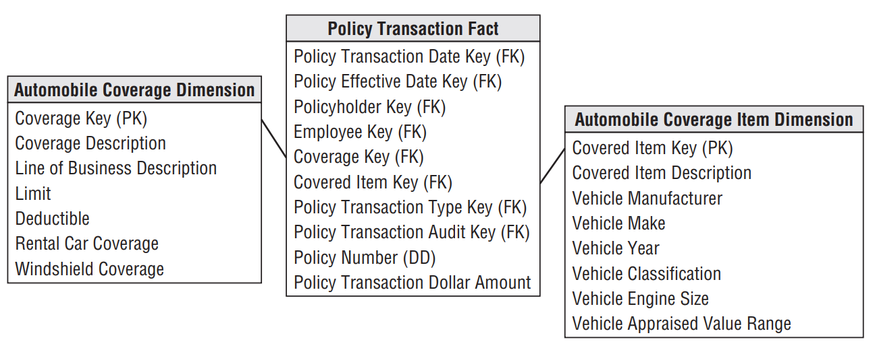
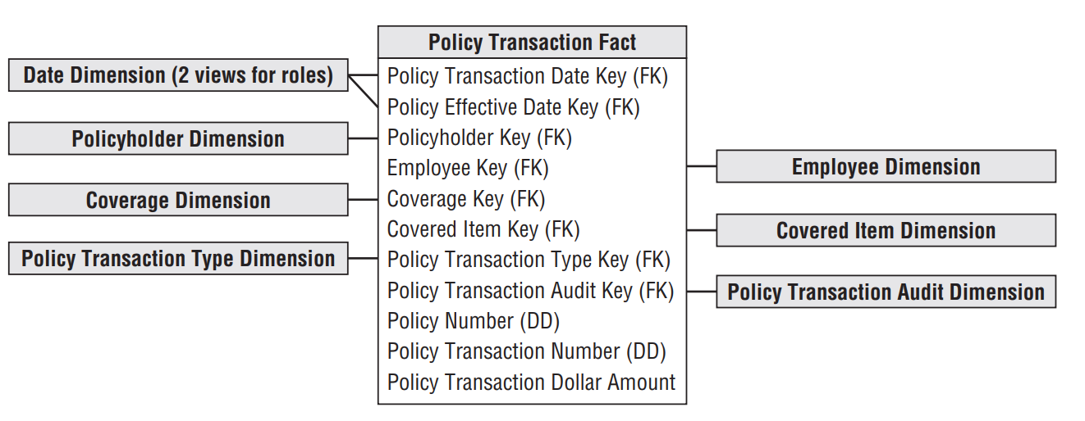
Supertype vs subtype in Policy Transaction Fact

Slide 26
﻿Step Dimension for Sequential Behavior
﻿Sequential measurements, need to follow a customer or a product through a series of steps, often measured by diﬀerent data capture systems.
﻿a sequential process comes from web events where a session is constructed by collecting individual page events on multiple web servers tied together via a customer’s cookie.
﻿The step dimension can be prebuilt to accommodate sessions of at least 100 steps.

Slide 27
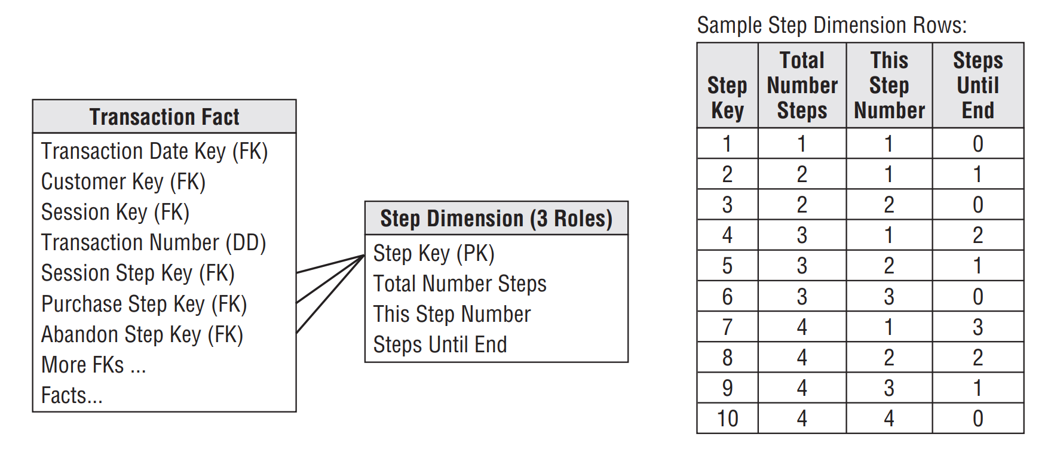
﻿Step dimension to capture sequential activities

Slide 28
Step Dimension for Sequential Behavior
﻿Step dimension can be associated with a transaction fact table whose grain is the individual page event.
﻿The first role is the overall session.
The second role is a successful purchase sub-session, where a sequence of page events leads to a confirmed purchase.
The third role is the abandoned shopping cart, where the sequence of page events is terminated without a purchase.
﻿A specific page can immediately be placed into one or more understandable contexts (overall session, successful purchase, and abandoned shopping cart)

Slide 29
Alternatives of Modeling Sequential Behavior
﻿Specific fixed codes for each possible step;
﻿Track customer product purchases in a retail environment and Track each product can be encoded;
﻿Separate the codes with a unique non-numeric character.
11254|45882|53340|74934|21399|93636|36217|87952|…etc.

